Slide 1
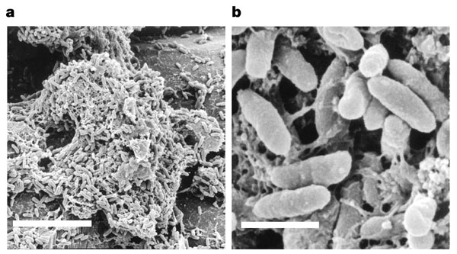
Gregory Palmer, Ph.D. State and National Event Supervisor
Microbe Mission 2018
Texas State Science Olympiad Coaches Clinic
November 18, 2017
10 μm

Slide 2
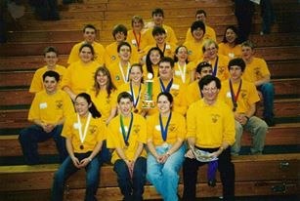
Proud Science Olympiad Alum!
Competed in Science Olympiad from 8th-12th grade
Serve on National Science Olympiad Rules Committee for Life Sciences
State and National Microbe Mission Event Supervisor
Re-started the UT-Austin Regional tournament

Slide 3

UT-Austin Regional Tournament
February 24, 2018
All 28 B and C events
Teams pick their 5 drop events
2017 Nationals participants grant regionals extra State Tournament bids

Slide 4
Cellular biology life sciences events cycle
2017-18: Microbe Mission B/C
2019-20: Designer Genes C and Heredity B
2021-22: Cell Biology C and Bio Process Lab B
2023-24: Microbe Mission B/C

Slide 5
Rules details
Must bring goggles (eye protection C)
Single page of notes not in sheet protector with no annotations affixed
2 non-programmable, non-graphing calculators

Slide 6
Event structure
Often students take an exam
Exam should contain lab activities
Event may be run as stations

Slide 7
Stations philosophy
Why have stations?
How can we keep stations fair/consistent for all teams?
How do you prepare your students for stations?

Slide 8
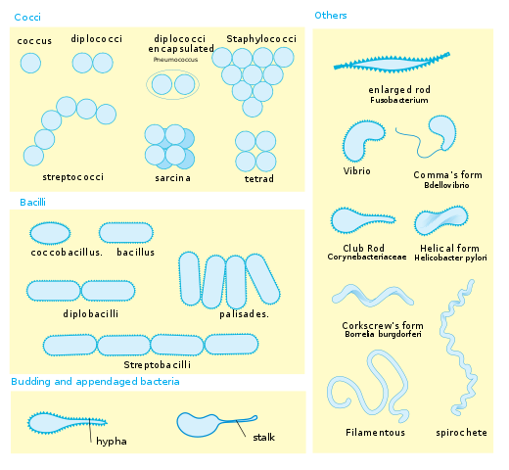
New topics
Names for and recognition of bacterial shapes is now a B/C topic
Cocci
Bacilli (rods)
Corkscrew/Spirochetes
wikipedia

Slide 9
New topics
Measuring bacterial growth for B and C
Direct counting
Counting chamber
Plate counts
Indirect counts
Turbidity (Optical Density)
Dry weight
Total DNA or Protein
Total cells vs. viable cells
Consider advantages and disadvantages of each method

Slide 10
New topics
Isolating bacteria by streaking and serial dilution (Div C only)
Goal is to get isolated colonies
One bacterium (in theory) forms one colony

Slide 11
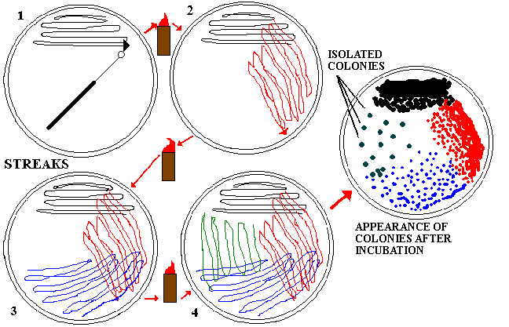
Streaking for isolation
http://www.personal.psu.edu/faculty/k/h/khb4/enve301/301labs/lab4pureculture.html

Slide 12
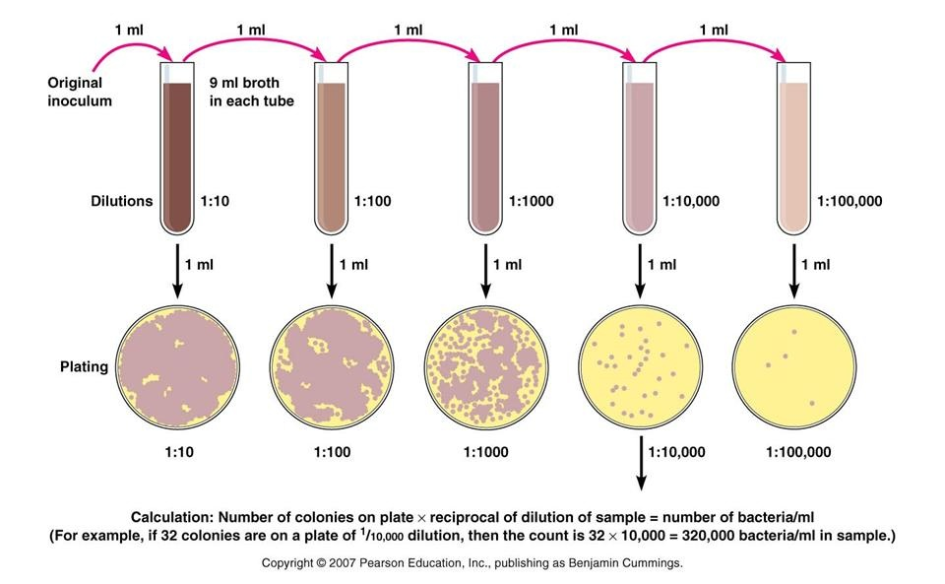
Serial dilution and plating
https://www.slideshare.net/sarah_jumali/serial-dilution

Slide 13
New items on disease list
Viruses: norovirus and zika virus
Protozoans: Naegleria
Bacteria: no changes state and regionals
Pseudomonas aeruginosa for nationals
Prions: chronic wasting disease
Fungi: White nose syndrome

Slide 14
Resources
National website has great resources
Student wiki is okay on most topics
Test exchange!
Our website (www.atxscioly.com) for UT-Austin exams!
Textbooks: Campbell (Pearson), Microbe (ASM), Microbiology: an Introduction (Pearson)
Austin Community College course notes: http://www.austincc.edu/rohde/noteref.htm

Slide 15

Questions?

